Slide 1
Independant Project:
DNA in the 1st
Grade Classroom
Tanner Solheim
Brad Keller
Jocelyn Johnston
Kaitlin Kucza
Courtney Kucza

Slide 2
Before We Could Begin
Deciding on project type
Finding a time
Age Group
Communicated through Facebook

Slide 3
Deciding on a Project
Original Idea:
Edible DNA

Slide 4
Deciding on a Project
Original Idea:
Edible DNA

Slide 5
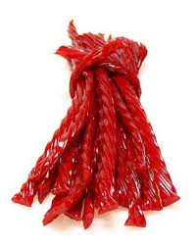
Deciding on a Project
Original Idea:
Edible DNA

Slide 6
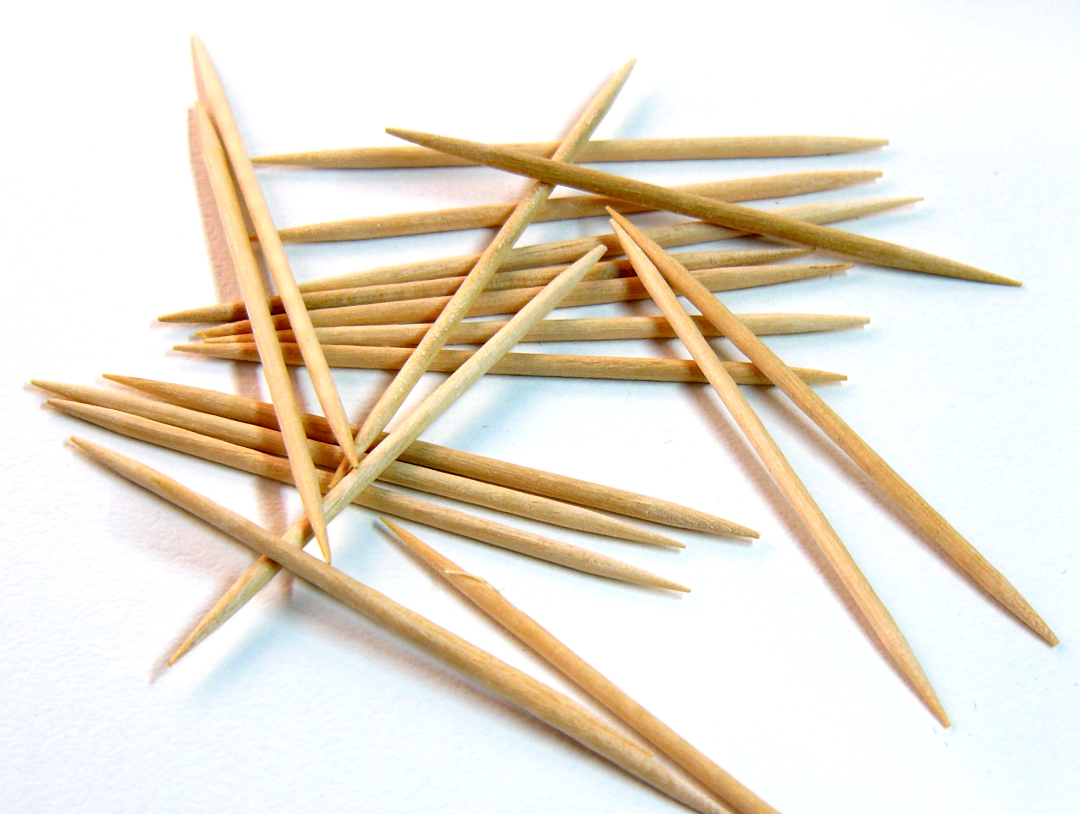
Deciding on a Project
Original Idea:
Edible DNA

Slide 7
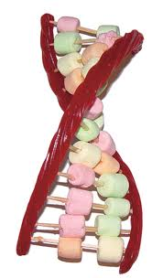
Deciding on a Project
Original Idea:
Edible DNA

Slide 8
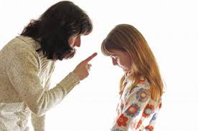
Possible Flaws to First Idea
Restrictions in the classroom
Respecting parents rules in children's diets

Slide 9
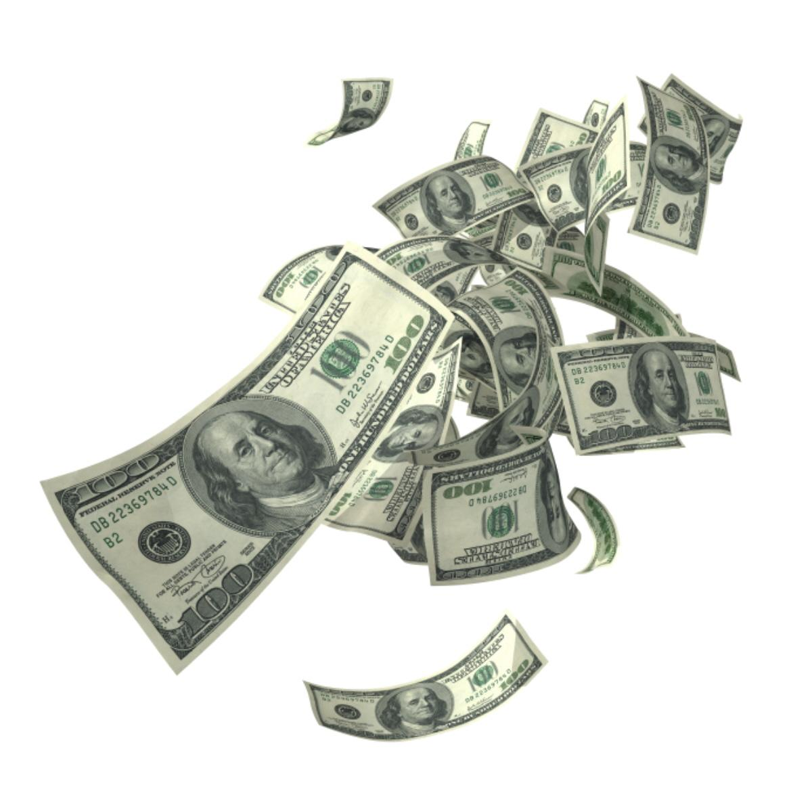
Possible Flaws to First Idea
Restrictions in the classroom
Respecting parents
The cost of providing the materials

Slide 10
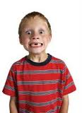
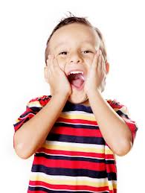
Possible Flaws to First Idea
Restrictions in the classroom
Respecting parents
The cost of providing the materials
Sugar affecting the students

Slide 11
Possible Flaws to First Idea
Restrictions in the classroom
Respecting parents
The cost of providing the materials
Sugars affect on children
Being aware of allergens

Slide 12
Second Idea
DNA Information Poster
A collective, kid-friendly poster about some easy concepts to make a connection of what DNA is was made.

Slide 13
Second Idea
Color By Numbers
Five blank color by number sheets were made each with a slightly different number sequence on the DNA. This was done so that each kid had a different animal their DNA would make.

Slide 14
Second Idea
Connect The Dots
Five blank connect the dots sheets were found online and printed off. Each one made a different animal (Snake, Bear, Bat, Frog, Dog) and would be handed out to the kids when they were done with the color by numbers.

Slide 15
Game Planning
Jennifer Olker
First meeting in SSB
Meeting in Coffee Shop
Final Meeting in SSB

Slide 16
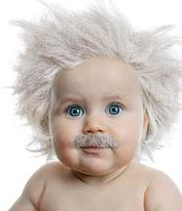
Jennifer Olker
Additional Ideas
Child Prodigies
What to expect

Slide 17
SSB #1
Solidified our plan!
Delegated Duties
Jocelyn=Grading Rubric
The Twins=Class Handout/Color By #
Brad=Dot 2 Dots and Copies
Tanner=Class Samples

Slide 18
Coffee Shop
Looked over handout
Received color by Number Files
Laminate class handouts

Slide 19
SSB #2
Finalized our classroom roles
Brad and Jocelyn= Introduction
Twins=Pass out handout
Tanner=Explain Class Activity
Extra Time we'd show them glo fish
Just go with the flow

Slide 20
In The Classroom..
Introduction
Point of Being There
What They'll Learn About

Slide 21
Cells
Building Blocks of LIFE
“If our cells were each the size of a grain of sand, our hands would be the size of a school bus!”
Cells are Extremely Small
200 Different Types

Slide 22
Deoxyribonucleic Acid
Made up of 4 Puzzle Pieces
Analogies: Recipe
Make Up Eyes, Hair,
and Who You Are
QUESTIONS

Slide 23
Introduce Project
Color DNA - Color By Number
Bring To Us
Get Dot-To-Dot
Find Out What They Made!

Slide 24
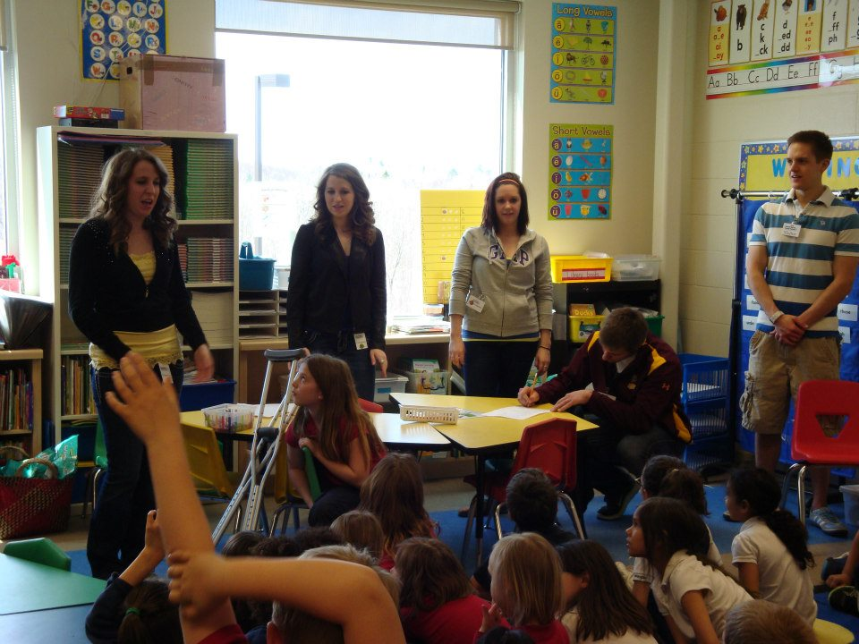
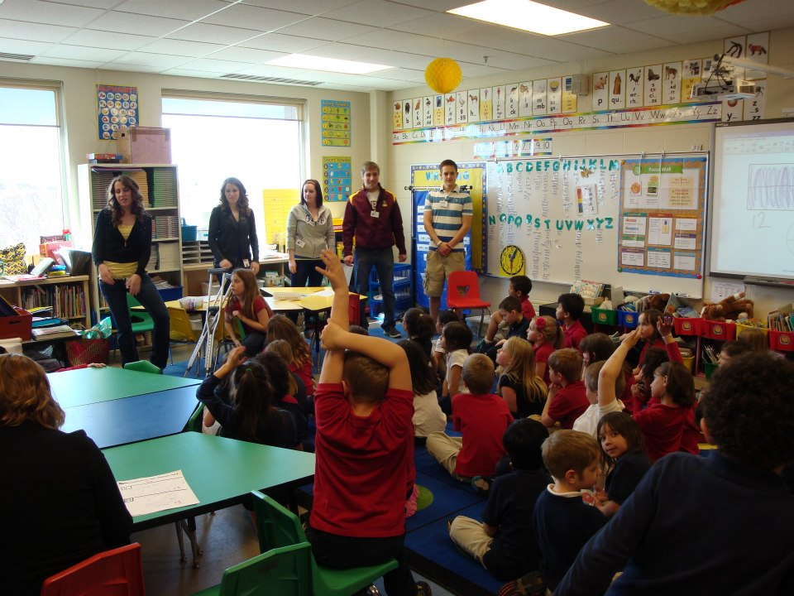
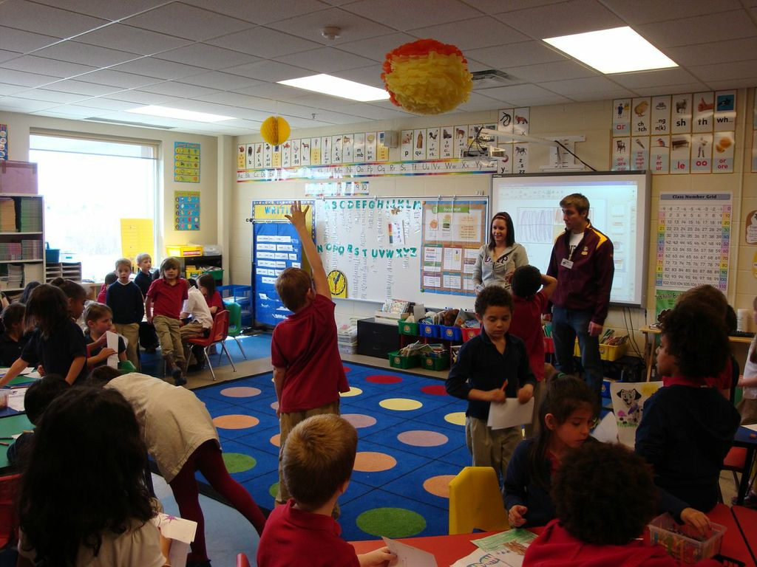
Pictures

Slide 25
Pictures

Slide 26
Color By Number DNA

Slide 29
Kids Reactions
The kids were very excited when we arrived.
Had a hard time containing themselves.
Were very eager to participate and ask questions.
They seemed to understand the basis our presentation.
The projects were age appropriate based on the outcome.

Slide 30
Our Reactions
We all felt that the presentation went great overall.
Overall we got the key points of the of the presentation across.
A few roadblocks happened with children wanting to blurt out answers or give answers or get off topic.

Slide 31
Kid's Value of the Presentation
The kids were able to understand how DNA pertains to their life at a basic level.
Meeting our group from UMD had the kids excited for learning.
They were able to do things that they enjoy such as coloring to understand basic DNA and see how a slight change in the sequence created different animals.
Made connections with their own life to relate to DNA and see what it is.

Slide 32
Our Value of the Presentation
It was great to go out into our community and get involved and inspire kids to strive to learn and dig deeper in their understanding of the sciences such as genetics.
Even though the presentation was a very basic take on DNA it allowed us to connect with the students and teach them about such things.
It showed us that our complicated, in depth experiments can be explained to young students by taking a small but important piece and showing how important it is to life on this planet.

